Slide 1
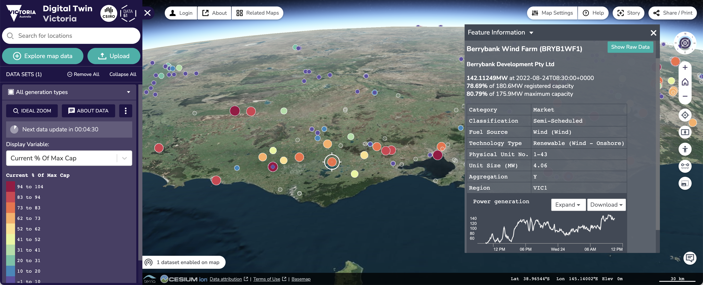
State of TerriaJS
Nick Forbes-Smith | FOSS4G 2022 Firenze

Slide 2
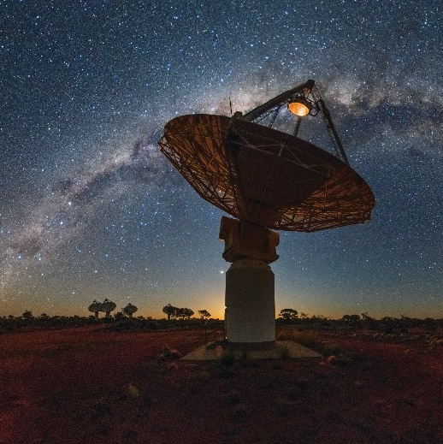

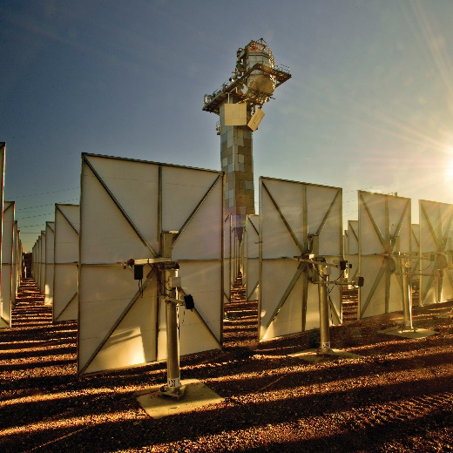
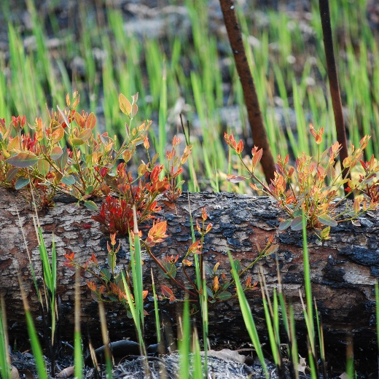
Australia’s national science agency
One of the world’s largest multidisciplinary science and technology organisations
5,200+ dedicated people working across 58 sites globally
State-of-the-art national research infrastructure
We delivered $7.6 billion of benefit to the nation in FY21
csiro.au
Notes:
Source: Page 6 of CSIRO’s Annual Report 2020-21

Slide 3

TerriaJS
An open-source framework for web-based geospatial catalogue explorers
Cesium/Leaflet based in-browser tool for looking at 2D and 3D data
Find us at terria.io

Slide 4
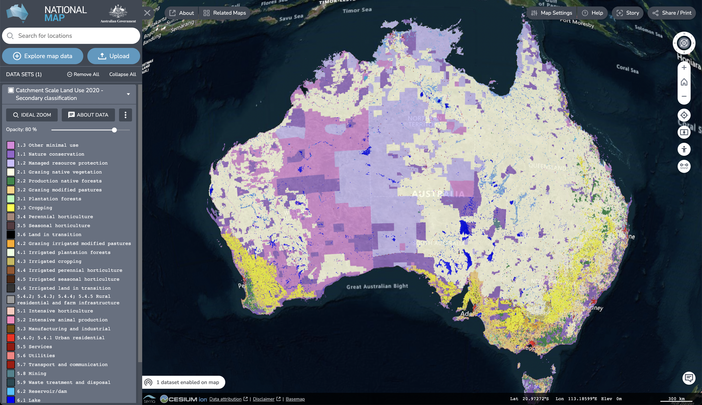
(Australian) NationalMap
nationalmap.gov.au
Birth of TerriaJS
Geospatial data discovery, visualisation and sharing
Launched 2014
14,000+ datasets, 30,000+ sessions/month

Slide 5






















TerriaJS Adoption by Community
Industry
Gov/ Research
NGOs

Slide 6
Version 8 release
Milestone V8 release 12 months ago
Rewrite from JavaScript (knockout.js) to TypeScript (React/mobX)
Becoming more stable/mature
Thank you to all contributors
Especially to Zoran Kokeza!

Slide 7
Some notable new features
Mapbox Vector Tile support using protomaps.js (+geojson-vt)
Edit style UI (for vector data)
3D clipping box
3D compare/splitter
New Plugin API - github.com/terriajs/plugin-sample

Slide 8
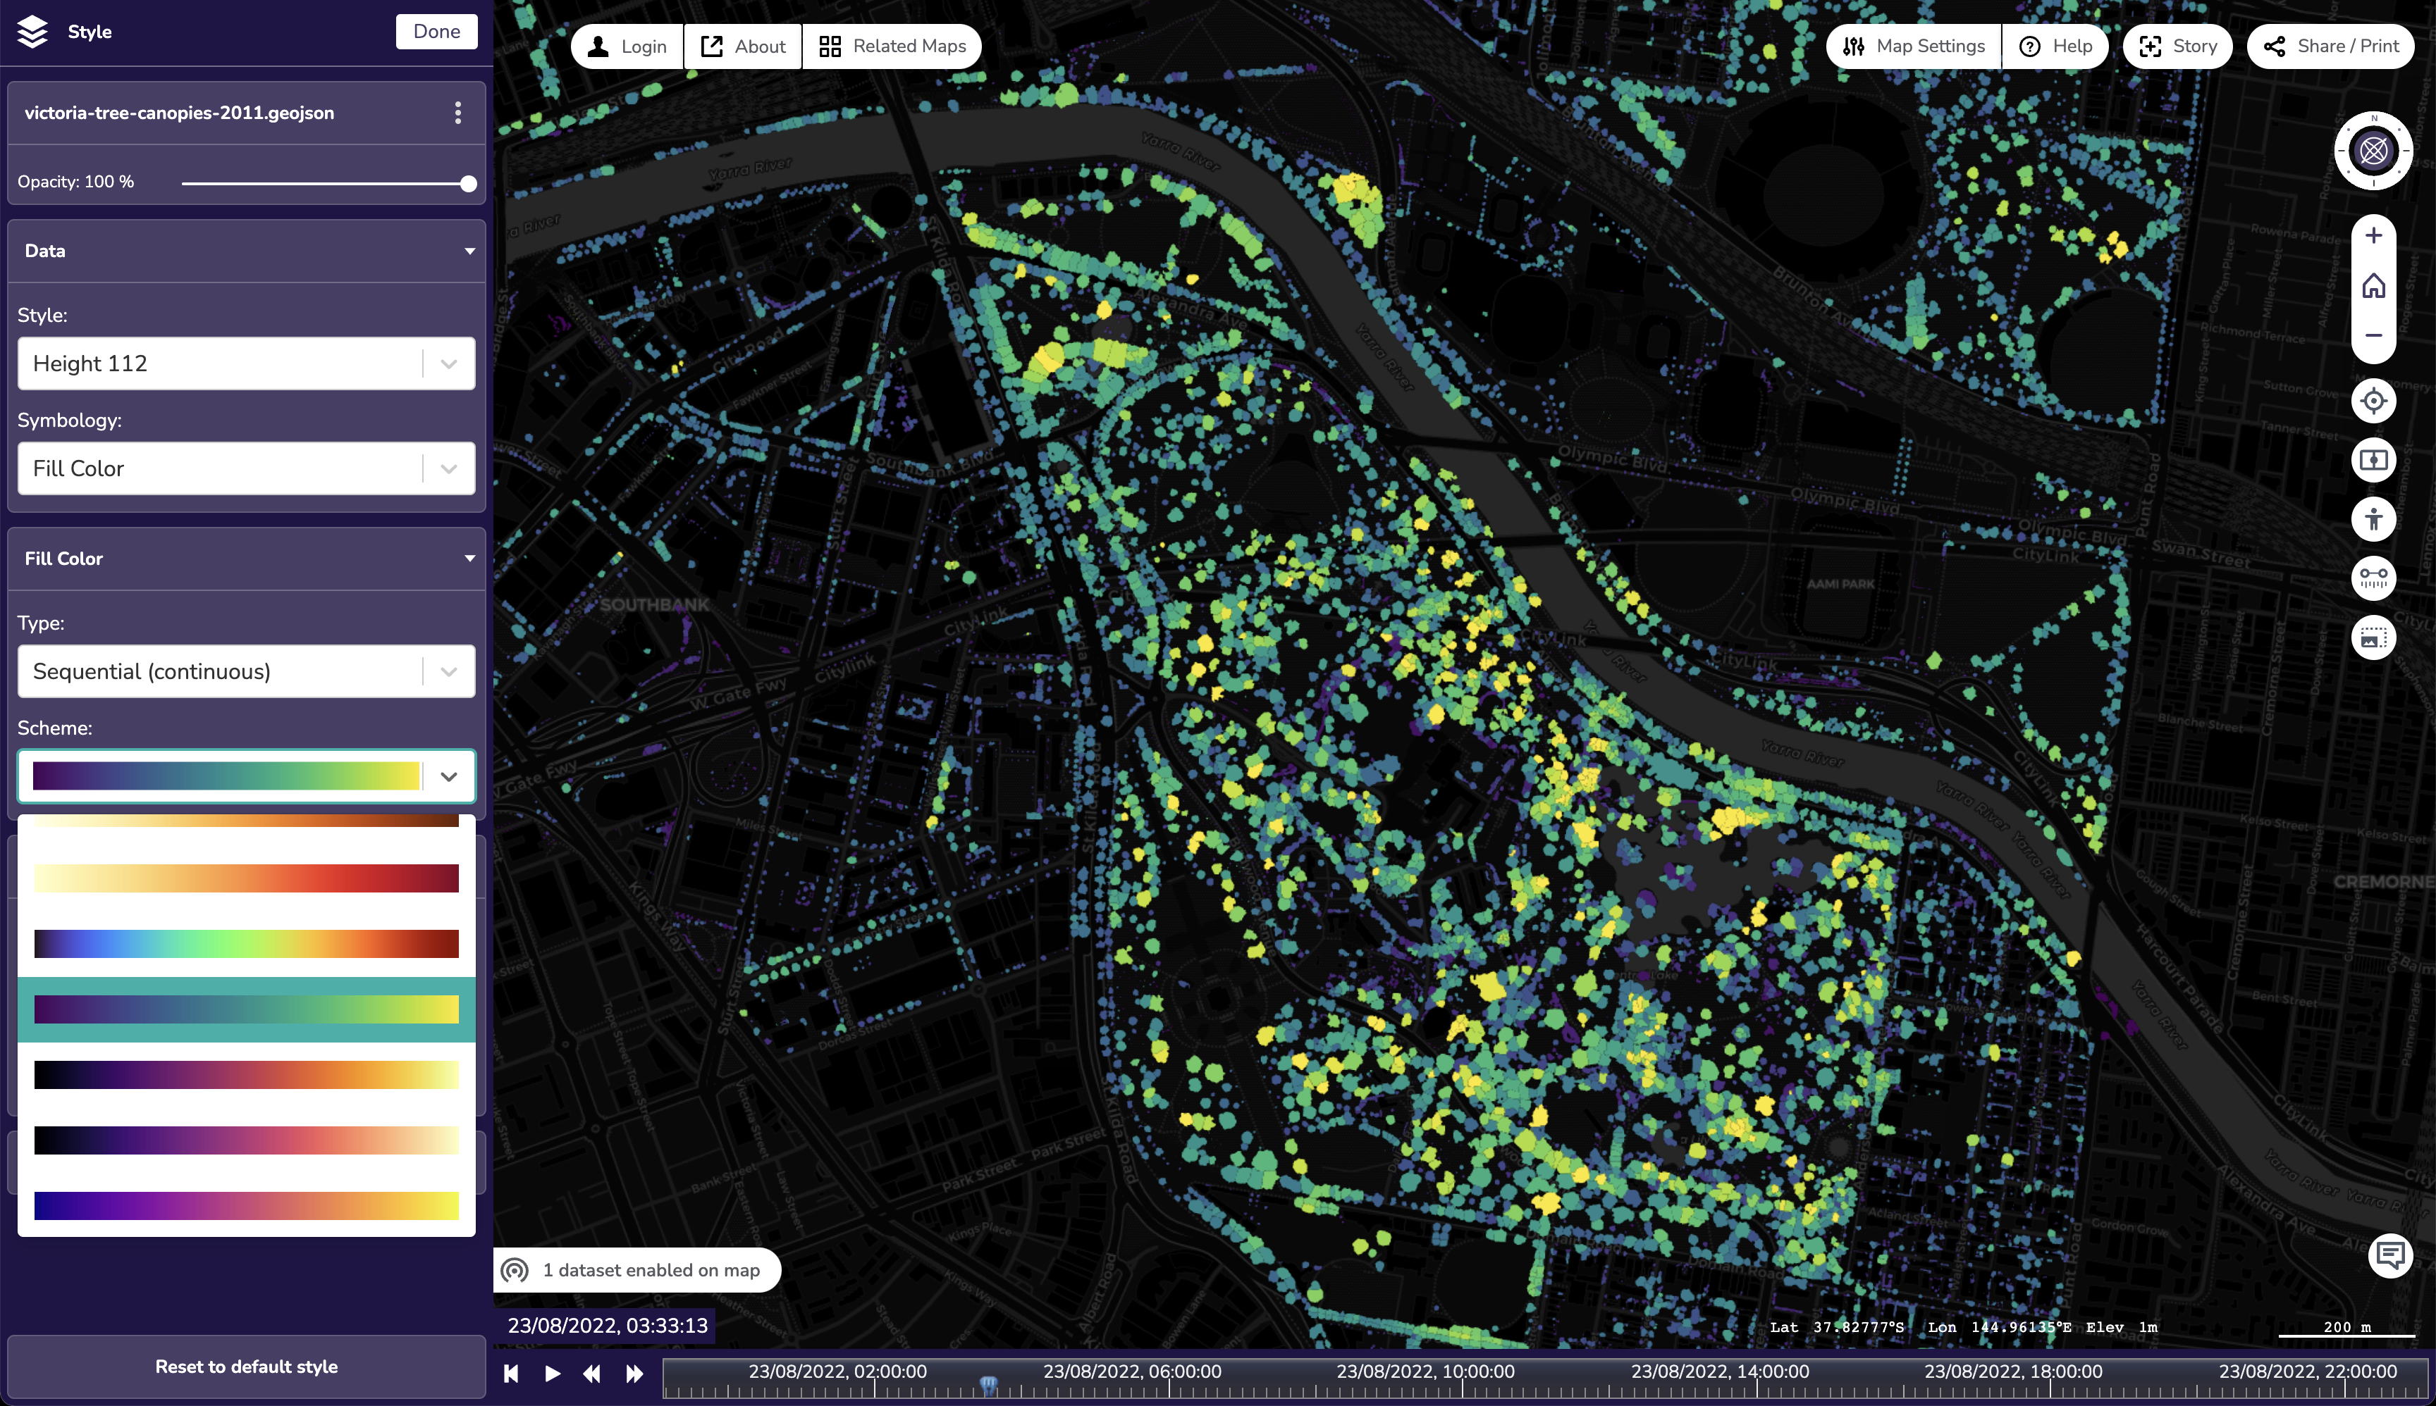
GeoJSON -> MVT + Edit style
vic.digitaltwin.terria.io
Notes:
Sequential continuous – set min/maximum values – color scale…

Slide 9
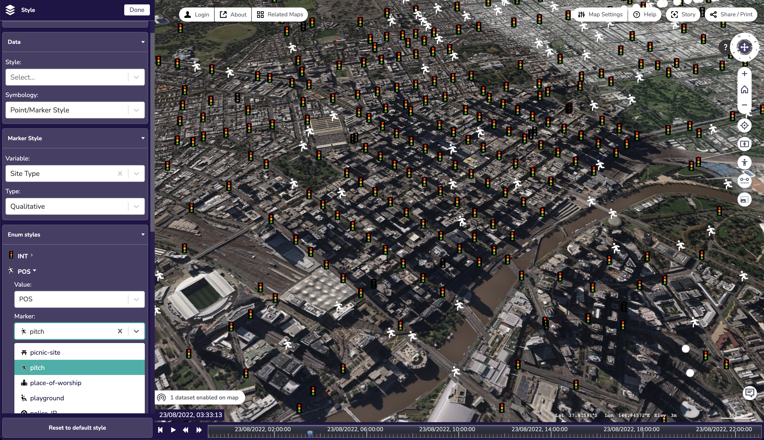
Edit style (marker)
vic.digitaltwin.terria.io
Notes:
ArcGisFeatureServer – pull in server vector styling – can be customised
Changed pedestrian crossing to pitch Maki icons

Slide 10
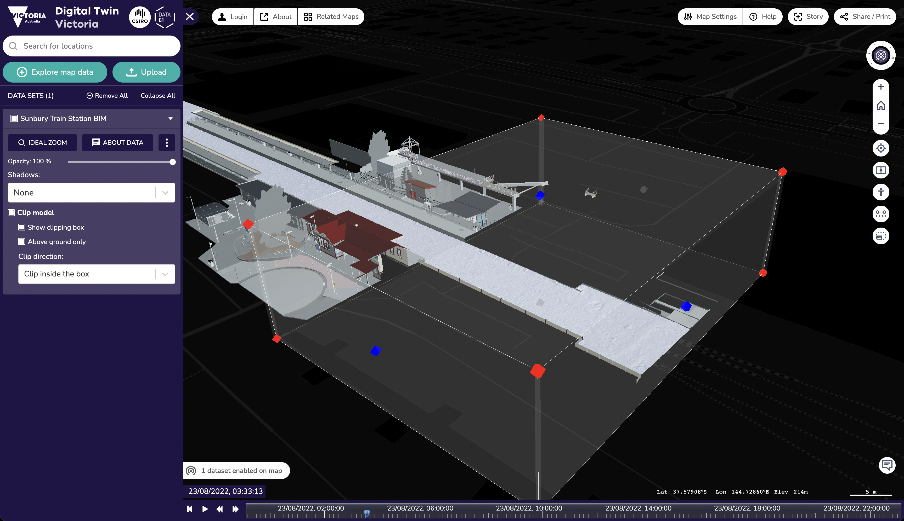
3D Clipping box
vic.digitaltwin.terria.io
Notes:
Ability to clip areas of 3D datasets – so you can inspect inside – or splice together multiple models

Slide 11
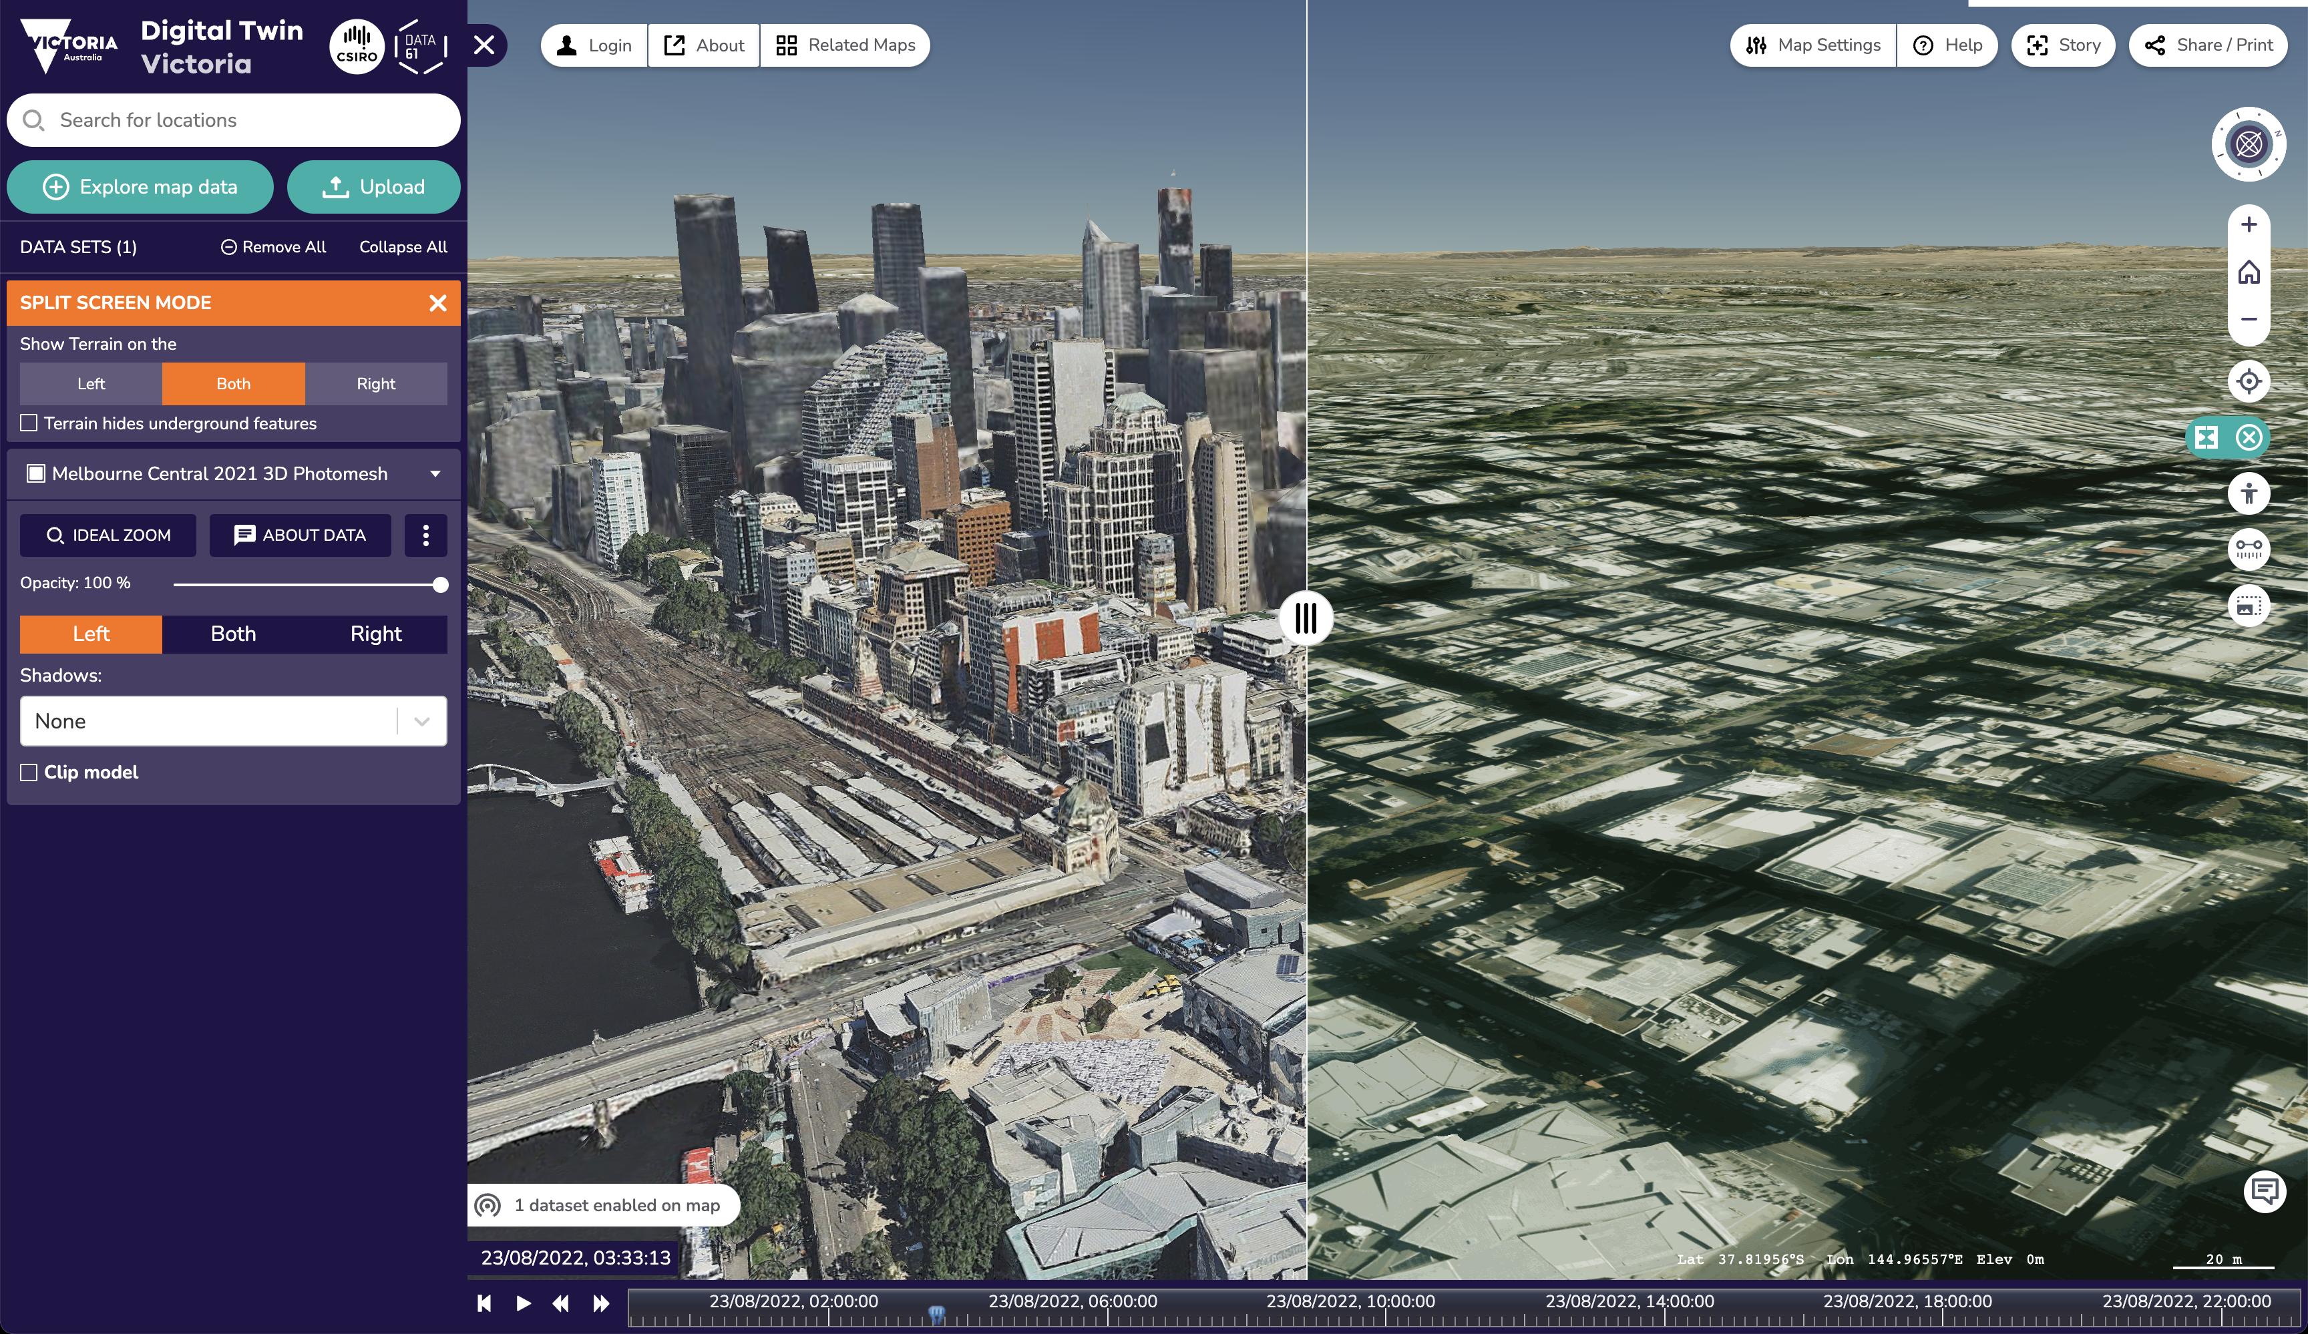
3D Compare/Splitter
vic.digitaltwin.terria.io
Notes:
Similar to clip box – but clips screen space to compare two datasets

Slide 12
Future plans
Story v2.0
Imagery Compare/Splitter v2.0
Catalog search by location
Upgrade to TypeScript 4.x
Mobile support…
Improve documentation…

Slide 13
My other talk!
Exploring the World’s Open Data Portals
Discovery, Visualisation and Analysis of Open Data with TerriaJS
Friday 12:30–13:00 in Room 4
Links
terria.io
github.com/terriajs
nationalmap.gov.au
vic.digitaltwin.terria.io

